Slide 1

NEW GREEN TAXI
A CAPSTONE PROJECT

Slide 2
INTRODUCTION
Report Aims To Build A Quantitative Model To Predict The Percentage Of Tip To Be Paid By Each Customer After A Taxi Trip.
The Nyc Green Taxi, Is Publicly Available On Nyc Taxi & Limousine Commission’s Official Website. Data Cleaning, Feature Engineering And Data Partitioning Procedures Were Performed Before The Model Is Constructed.
The Least Absolute Shrinkage And Selection Operator (Lasso) And Linear Regression Were Applied During The Modeling Process.

Slide 3
CONTENT
.INTRODUCTION
PROBLEM STATEMENT
METHODOLOGY
EDA(EXPLORATORY DATA ANALYSIS)
DATA PREPROCESSING
MODEL BUILDING
EVALUATION.

Slide 4
PROBLEM STATEMENT
Introduction to Green Taxi’s and the company structure.
Introduction to the Product.
Company Strategy and targets.
Operating environments.
Group Development.

Slide 5
METHODOLOGY
We will proceed with reading the data, and then perform data analysis.
The practice of examining data using analytical or statistical methods in order to identify meaningful information is known as data analysis.
After data analysis, we will find out the data distribution and data types. We will train 5 Regression algorithms to predict the output.
We will also compare the outputs. Let us get started with the project implementation.

Slide 6
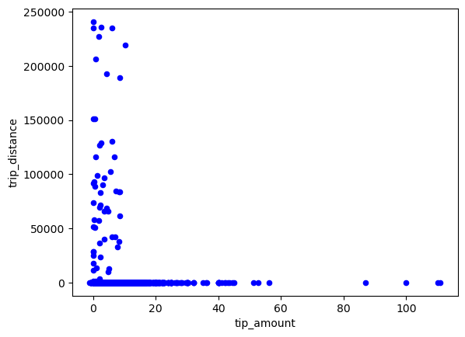
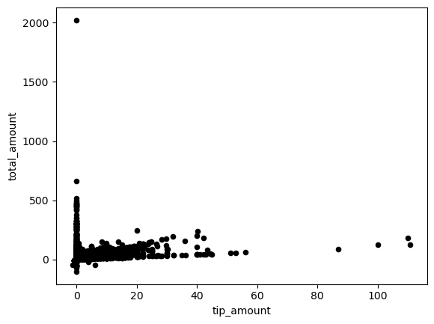
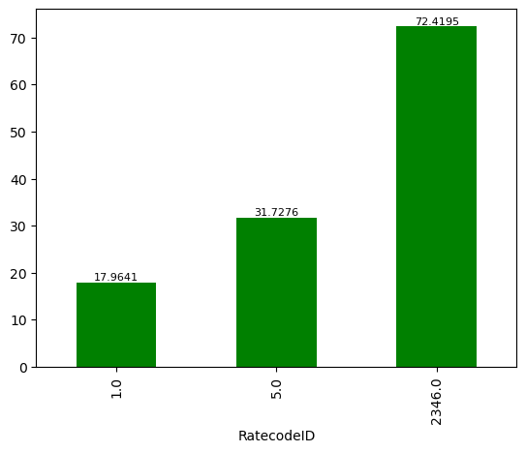
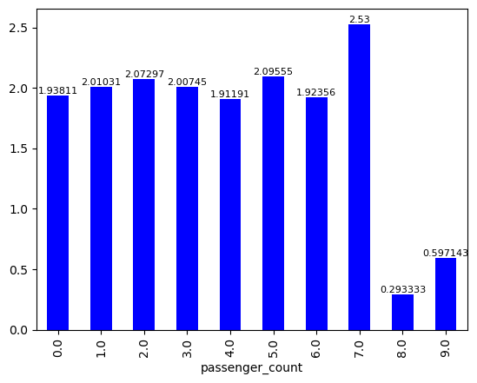
EXPLORATORY DATA ANALYSIS

Slide 7
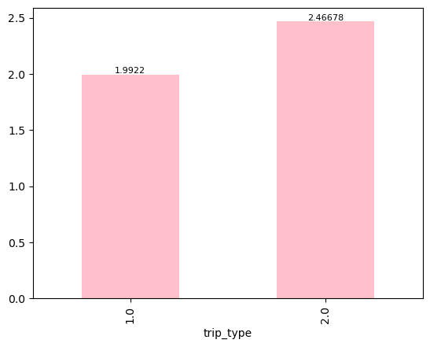
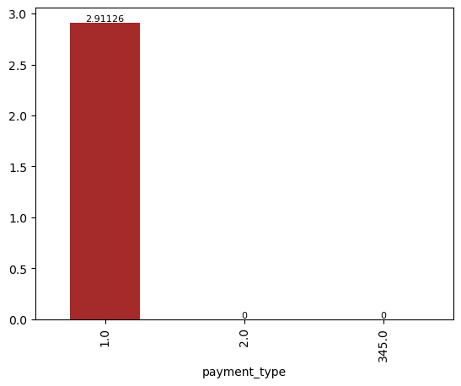
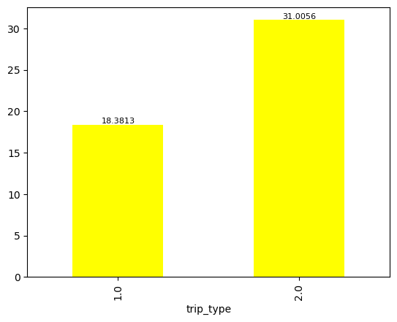
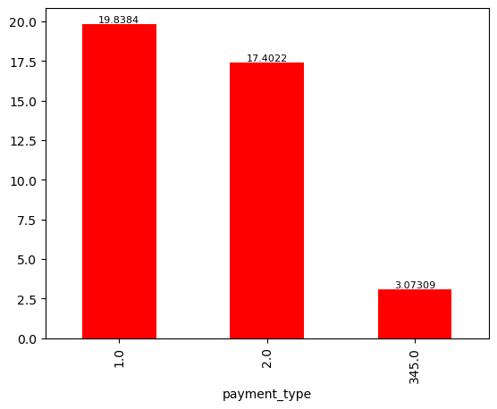

Slide 8
DATA PREPROCESSING
DROP NULL COLUMN
DATA SPLITTED INTO NUMERIC AND CATEGORICAL
NULL VALUES FOR NUMERIC VARIABLES
NULL VALUES FOR CATEGORIC VARIABLES
MEDIAN IMPUTATION

Slide 9
MODEL BUILDING
** After Data preprocessing the Data is Split into X and y
** The Models that we Built are:
Linear Regression
DecisionTreeRegressor
RandomForestRegressor

Slide 10
MODEL EVALUATION AND CONCLUSION
Model | Accuracy Score
Linear Regression | 0.27
DecisionTreeRegressor | 0.85
RandomForestRegressor | 0.94
Out of all Algorithms Random Forest Regressor has performed good.
I Entered the predicted test values into the competition learning: Total_amount all of the models the most accurate Regressor method is Random Forest Regressor with Accuracy 0.94 using n_estimator=1000

Slide 11
THANK YOU
Uppalanchi vivek
chintuvivek574@gmail.com
PGA 26

